Slide 1

Bubble
Team 4 (Hun-Min Park, Sang-Gyun An, JongMin Jin)

Slide 2
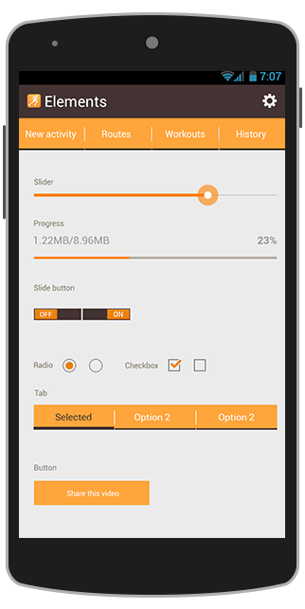
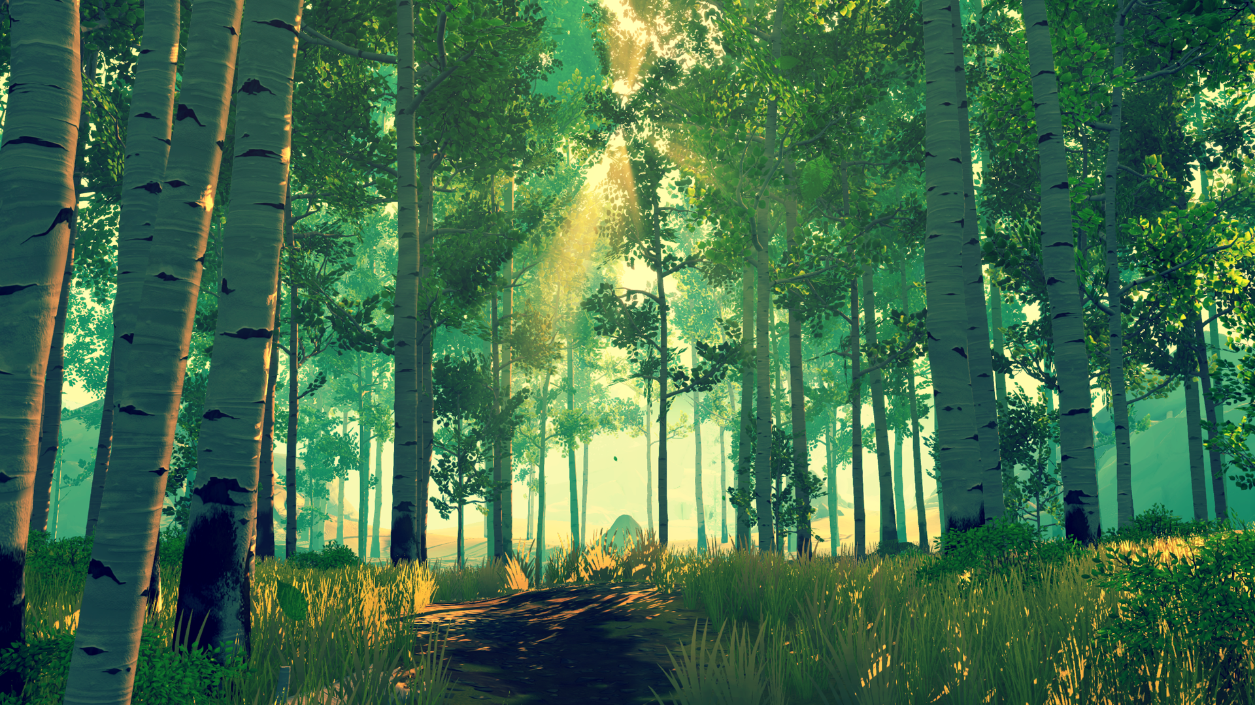



Start
Flying
Let’s blow a virtual bubble as far as you can!

Slide 3
Project schedule
Step 1
Project
Setup
Step 2
Basic graphics
&
physics
Step 3
Advanced graphics
Step 4
Alpha ver.
Step 5
Beta ver.
Presentation 1 (10/13)
Presentation 2
(11/03)
Presentation 3 (11/17)
Presentation 4
(12/01)
Final
(12/14)

Slide 4
Step 1: Project setup ( ~ 10/12)
Fundamental Android project
Basic modules
Basic OpenGL 3D world

Slide 5
Fundamental Android project
Activities
IntroActivity
MainActivity
ScoreActivity
Models
Drawable
Collider
Deformable
Bubble
Tree
Bird
Map
...
Views
MyGLSurfaceView
Button
…
Event
EventHandler
SoundHandler
GyroHandler
Utils
Matrix
…
...

Slide 6
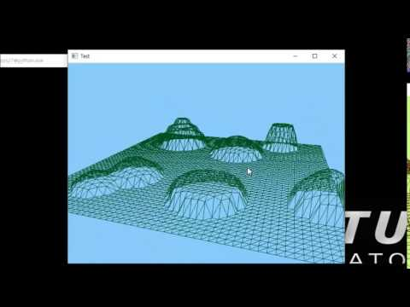
GL 3D world + Map generator
Draw a large square first.
Divide it into evenly-spaced small squares.
Pick a point P among the vertices. Let h and r height and radius of the ‘hill’.
For the points X = (x, y, z) such that |X-P| ≤ r, replace the value of y to y_new = max(h*exp(-(|X-P|/r)^2), y)
This makes a ‘hill’ on the map.
Modifying the formula gives us different kinds of hills. ex) ‘stairs’, ‘cliffs’, etc.

Slide 7
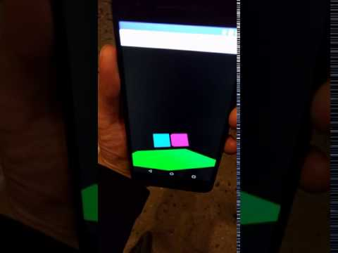
Rotate view by rotating Android device
Gyroscope sensor

Slide 8
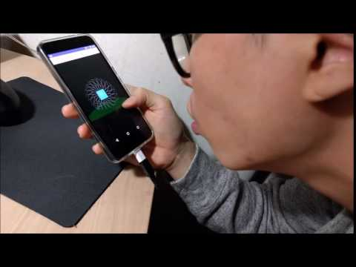
Move object by blowing
Android microphone → sound level → translation matrix

Slide 9
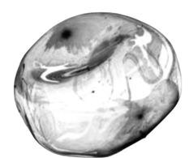
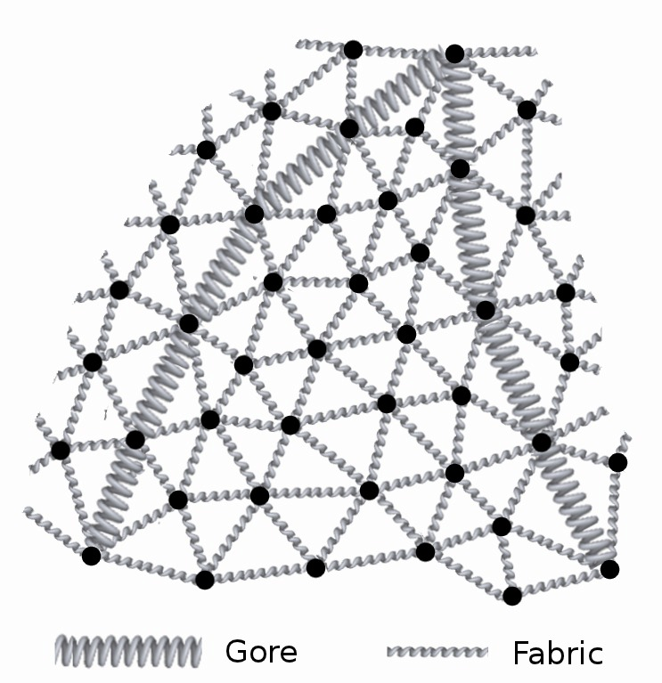
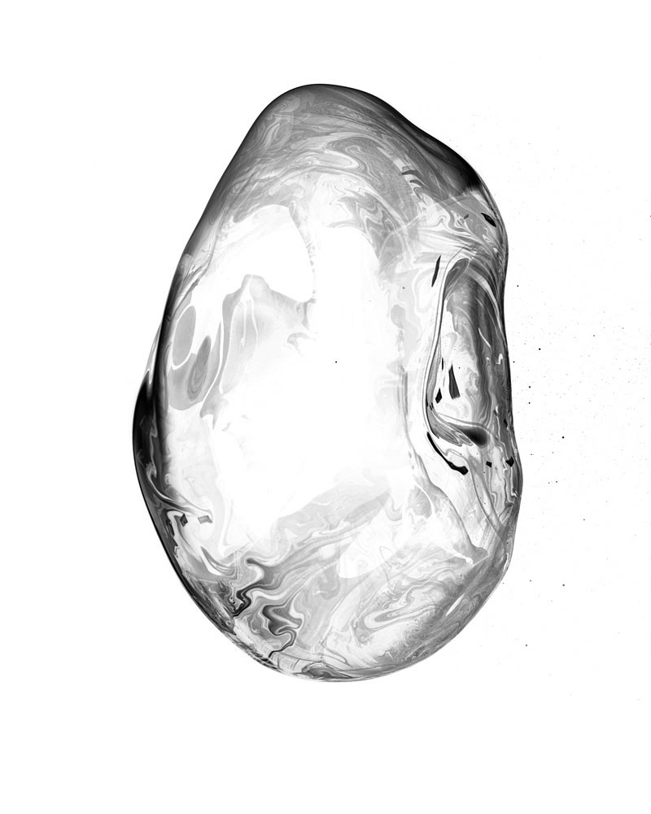
Step 2: basic graphics & physics (10/14 ~ 11/02)
Models
Bubble
Obstacles (e.g., tree)
Physics simulation
Gravity
Hook’s law for spring-mass model
Collision

Slide 10
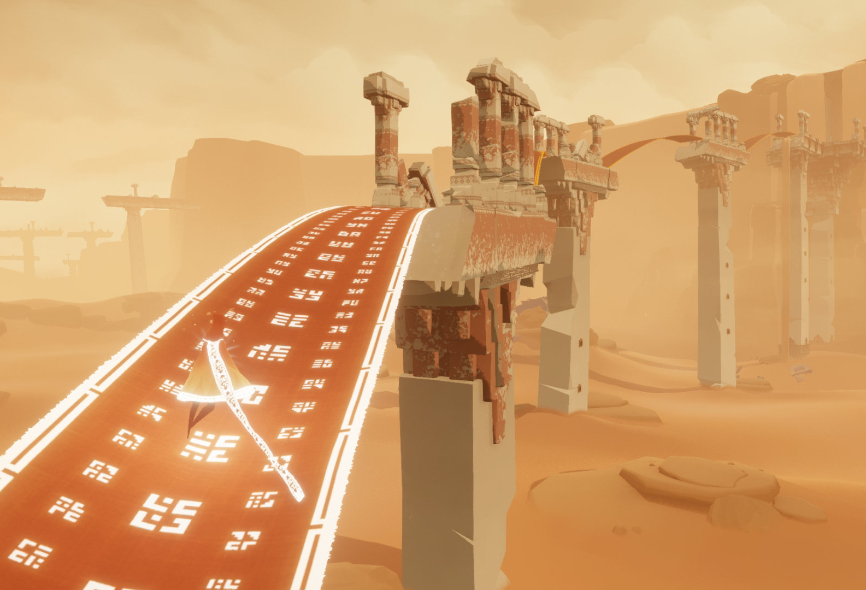
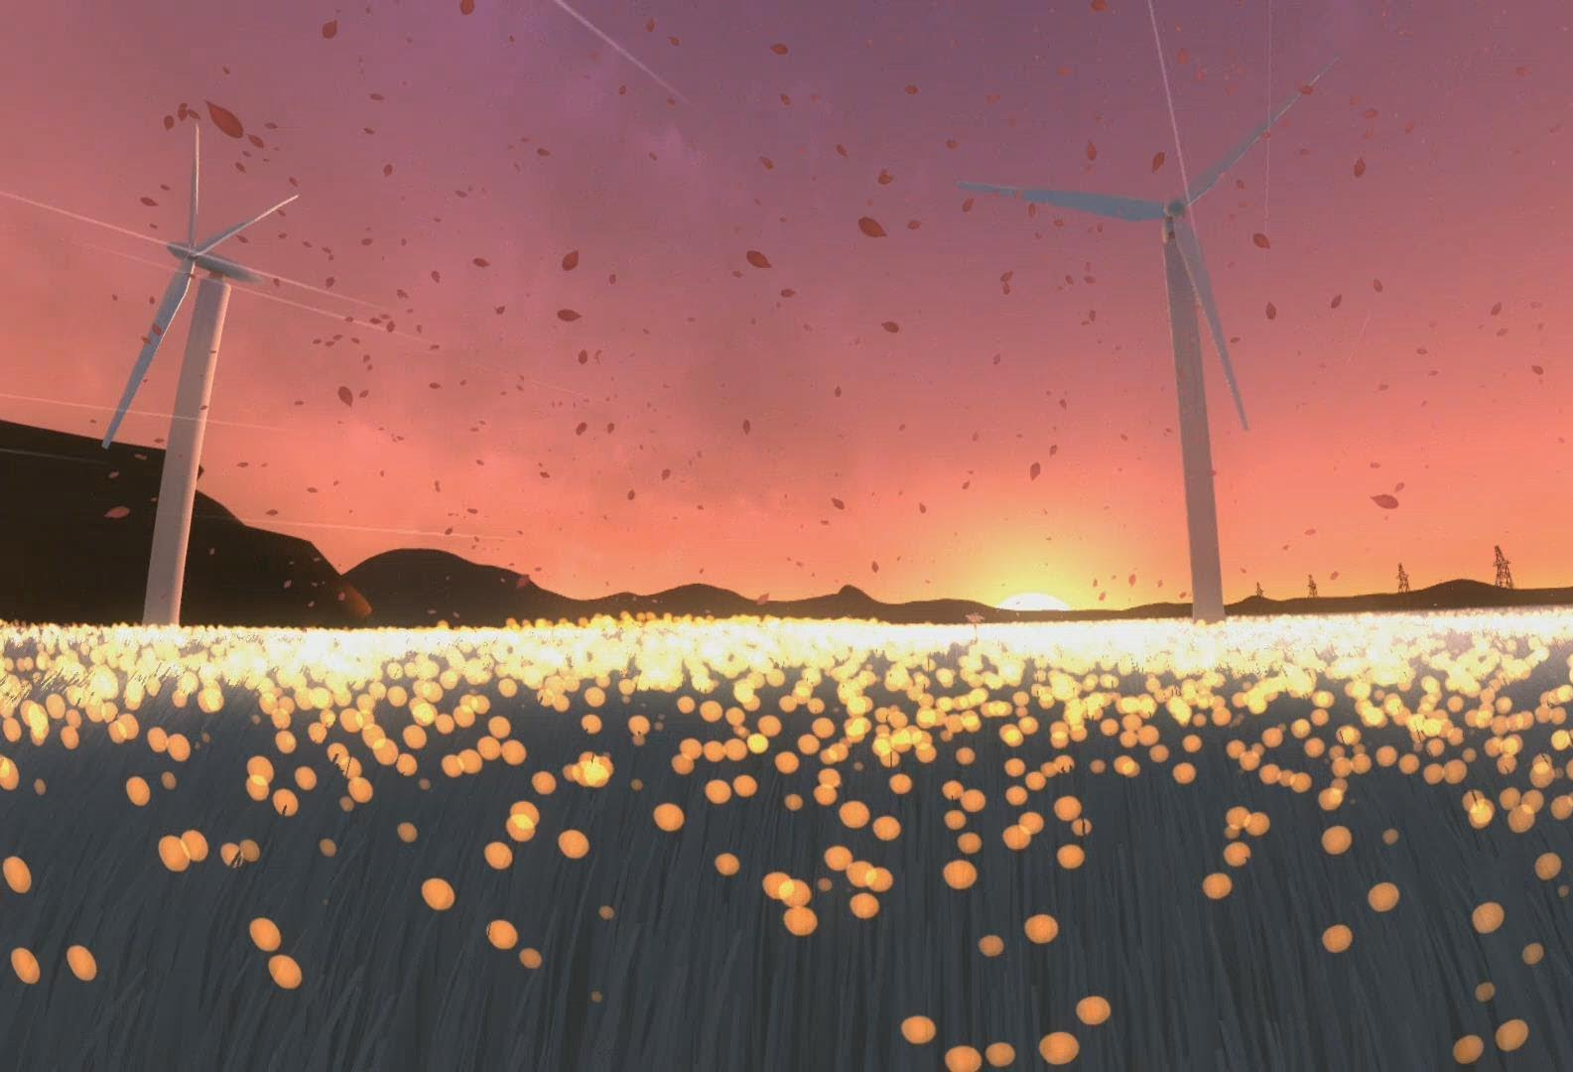
Step 3: Advanced graphics (11/04 ~ 11/16)
Shader
Lighting for better atmosphere
Texture for a realistic background

Slide 11

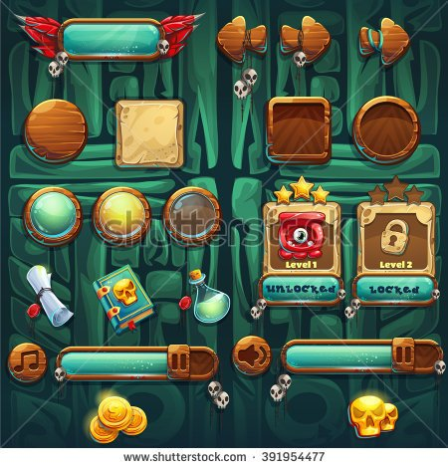
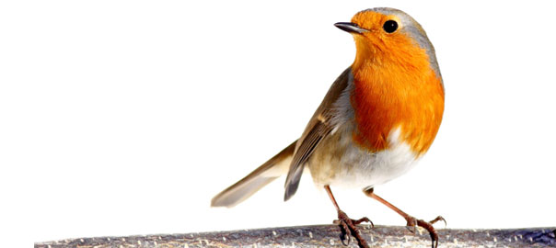
Step 4: alpha ver. (11/18 ~ 11/30)
Game logic
Level design
Different map
Obstacles
UI graphic

Slide 12

Step 5: Beta ver. (12/02 ~ 12/13)
Validation by user test
Final improvement
Prepare final presentation

Slide 13
Thank U

